Slide 1
AI Driven Entity Intelligence & Risk Analysis Hackathon
Team Name : InnovAItors

Slide 2
Tools & Frameworks Used
Visual Studio Code IDE
Python 3.12
Agno v1.1.17 (formerly Phi data) framework for Agentic AI workflow (Open Source)
Groq API free tier for remotely hosted LLM access
Models powering the Agno agents via Groq API
llama3-70b-8192 LLM ,
llama-3.3-70b-versatile,
deepseek-r1-distill-llama-70b

Slide 3




Design and Architecture
Expose as API for external trigger
Start
Agno Agentic AI Framework
Multi Agent Team Coordinator
File Tool (write json file)
Data Analyst Agent
Research Analyst Agent
Risk Analyst Agent
Local host
PDF Reader Custom Tool
ML Model for Risk Scoring via Custom API Tool
Risk Scoring ML Model via REST API
Duck Duck Go Search Tool
News Paper Tool

Slide 4
Agentic Workflow Steps Description
The execution starts with the Multi Agent Team coordinator receiving the request for entity intelligence and risk analysis. Both structured and unstructured transactions will be contained in a pdf file available to the tool for processing. The team is divided into 3 agents and the coordinator agent coordinates the tasks sequentially between them –
Data Analyst Agent - This agent processes the transactions from the pdf as text using the custom pdf reader tool given to it and extracts the transaction Ids, Entities list, transaction amounts from the text.
Research Analyst Agent – This agent uses the extracted entity list and searches the internet websites in real time using duckduckgo search tool and newspaper tool to extract more information about the entity to classify it as organization, individual, NGO, PEP etc along with confidence score based on evidence.
Risk Analyst Agent – This agent uses the information extracted by Data Analyst agent, Research Analyst agent and uses the parameters entity type, transaction amount, country to predict the risk score using a pretrained ML model hosted locally using API (ML model is random forest regression model). It uses a custom python tool to call API.
The Multi Agent Team coordinator then combines the output from all the 3 agents to generate the final JSON response and write it to a json file in the pre configured ‘out’ folder path.

Slide 5
Challenges Faced in implementation/ Solution Limitations
We couldn’t find free api keys for OpenCorporates, OFAC , so used internet search instead by asking the agent to search these websites.
Free tier of Groq API for LLM access has limits. So we were running out of limits multiple times while running the agents esp. the Research Analyst agent.
LLM model hallucinations are occurring repeatedly, and the output isn’t consistent every time.
We didn’t have enough test data to train the risk scoring model, so synthesized some data but accuracy on real data will be low (underfitting).
Anamoly detection couldn’t be implementation due to lack of enough data set and time constraint.

Slide 6
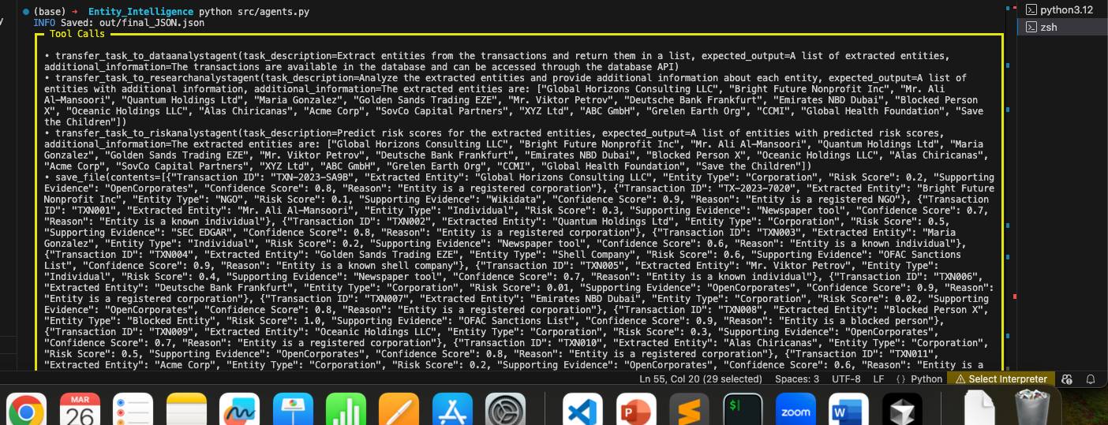
Sample output of the solution

Slide 7
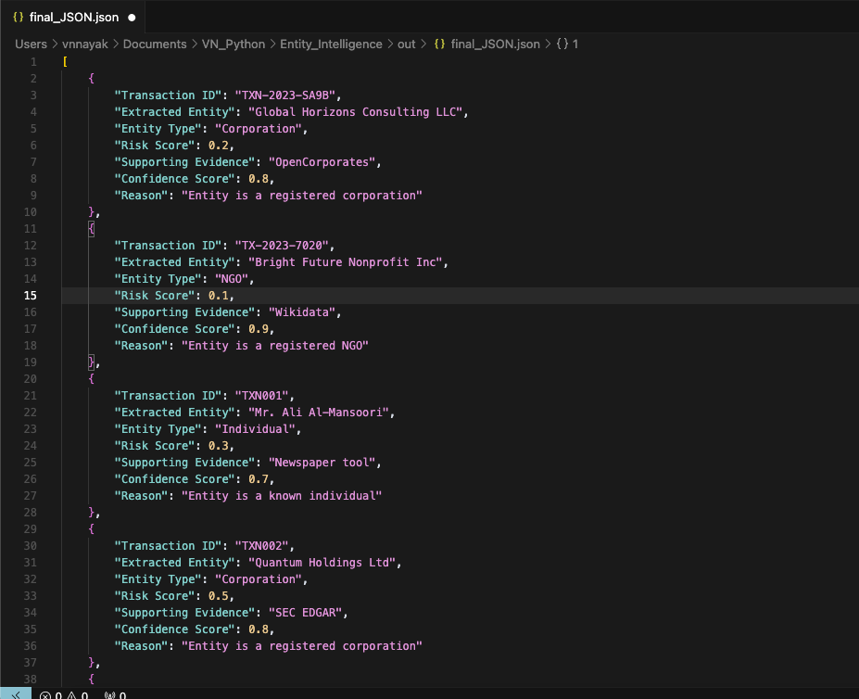
Sample output json generated by the solution

